Slide 1



[이미지처리팀]
Explaining in Style:
Training a GAN to explain a classifier in StyleSpace
Oran Lang, Yossi Gandelsman, Michal Yarom
Google Research
딥러닝 논문 읽기 모임
이미지처리팀 : 김상현, 고형권, 허다운, 조경진, 김준철, 전선영(발표자)
2021.10.31

Slide 2
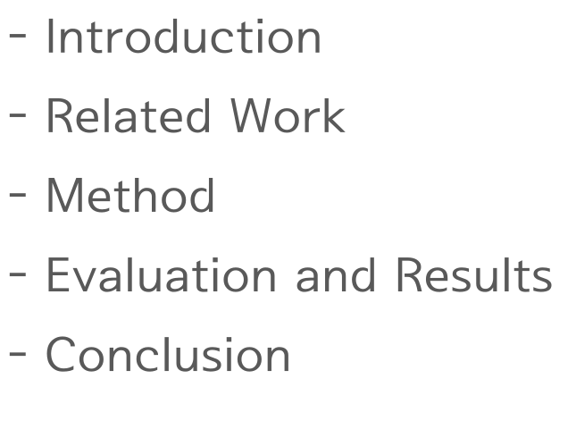
Contents

Slide 3
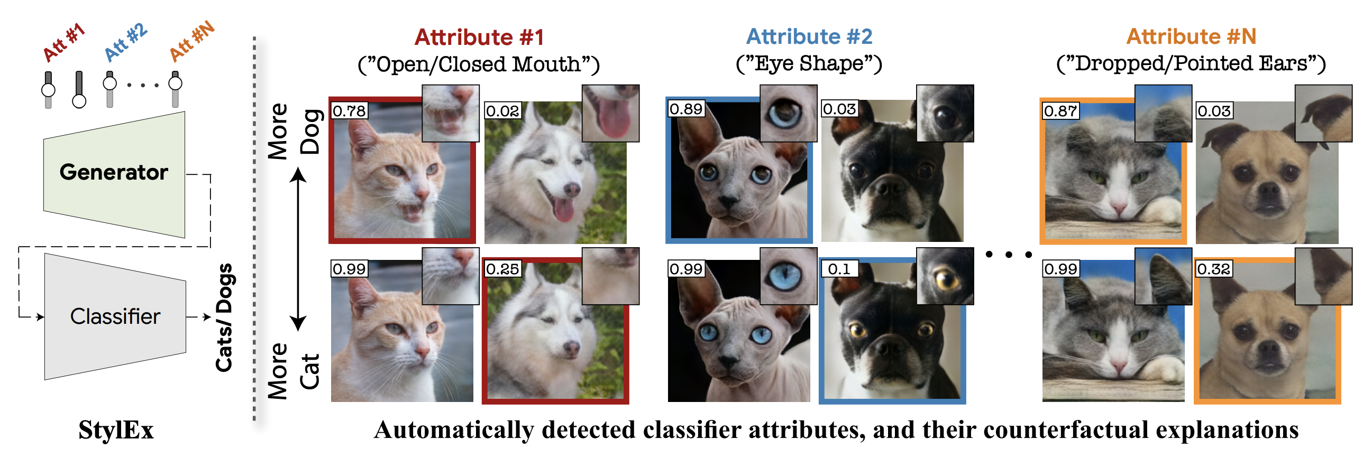
Abstract
StylEx
Visualize the effect of changing multiple attributes per image.
Provide image-specific explanations.

Slide 4
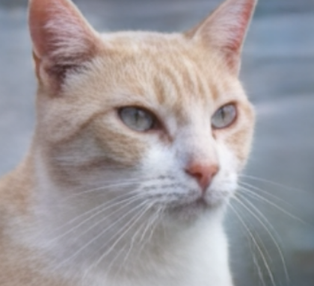
Abstract
Explaining a classifier
Dog vs Cat classifier
We want to explain a dog vs cat classifier.
We want to understand why this specific image was classified as a cat.

Slide 5
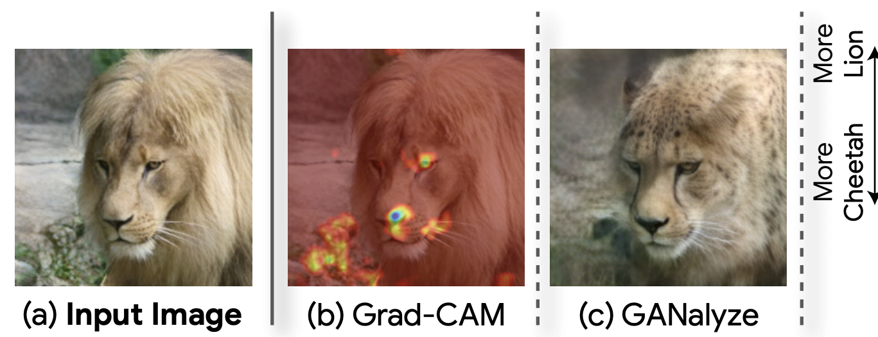
Related Work
Heat-map
Limitation: cannot visualize/explain well attributes that are not spatially
localized, like size, color, etc.
Counter factual explanation
“ If input X been X’ ➞ classifier output Y would change to Y’ ”
Limitation : their visualization changes all relevant attributes at once

Slide 6
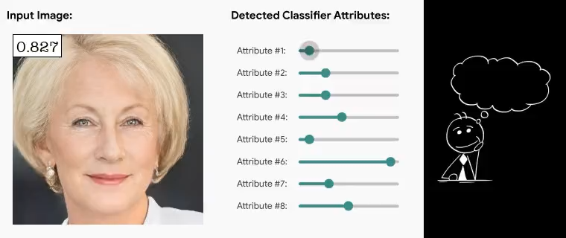
Method
Our Approach
Automatically discover disentangled attributes
➞ generate counterfactual examples

Slide 7
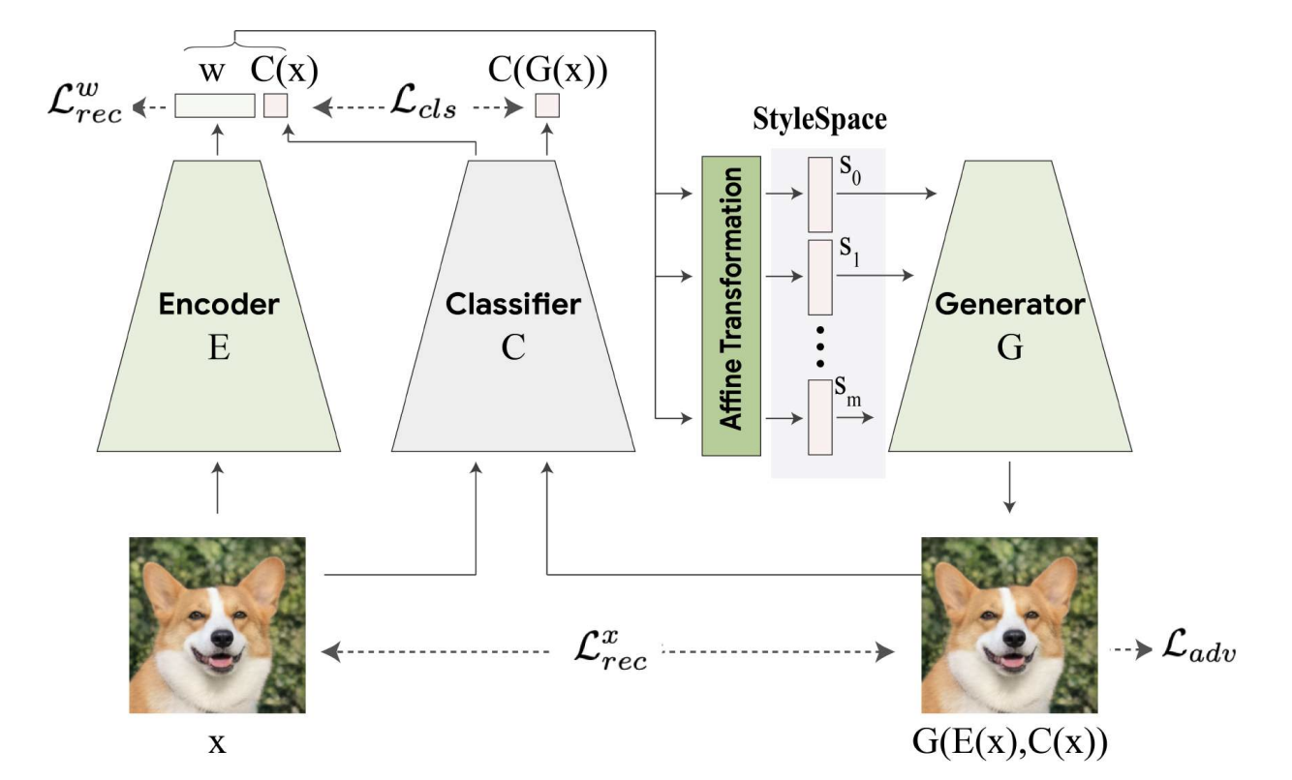
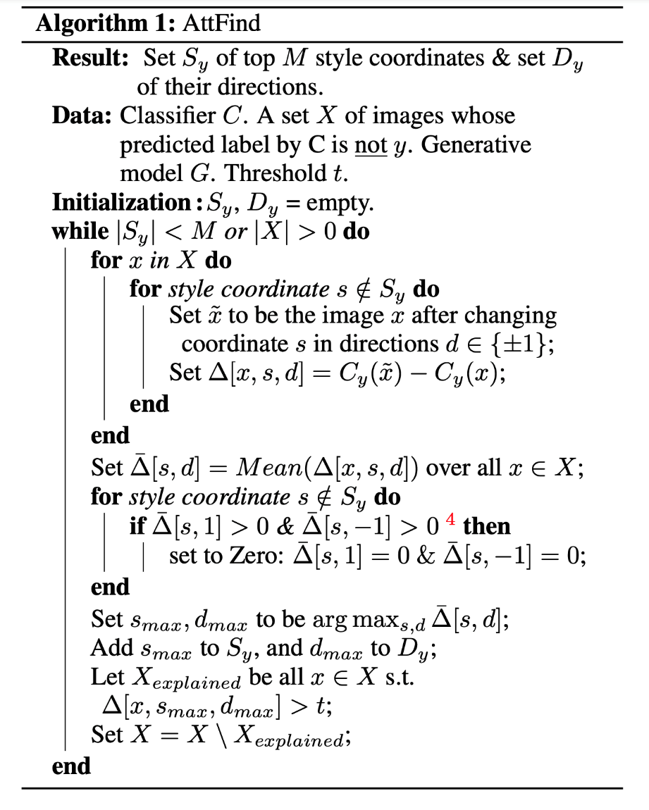

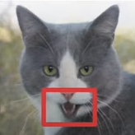
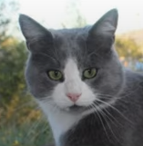
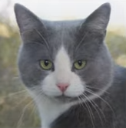

Method
StylEx architecture
To explain the classifier output on any given input image.
To ensure that the generative model captures classifier-related attributes by using the Classifier-Loss.

Slide 8
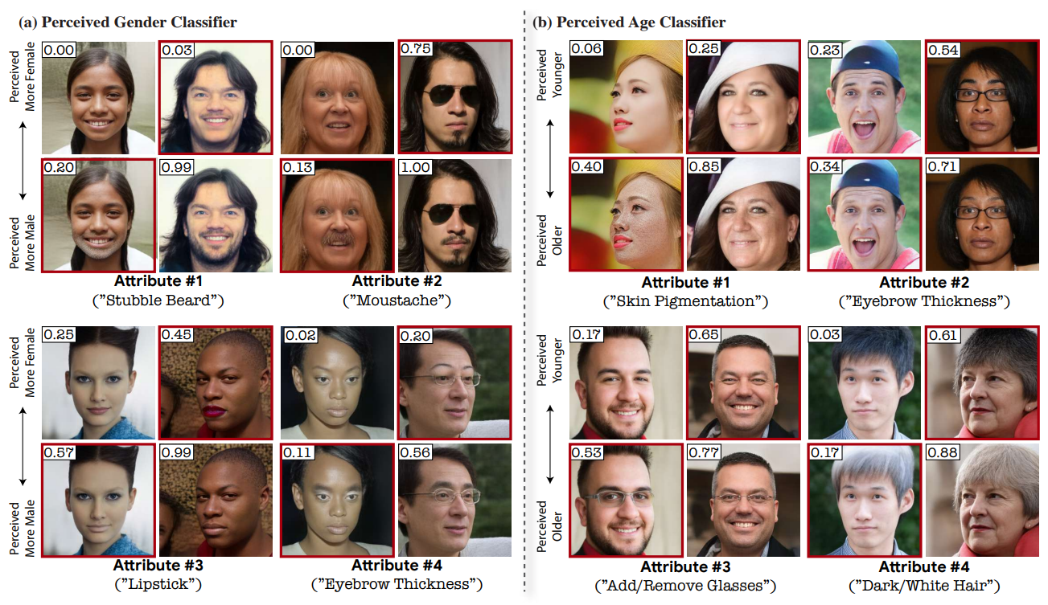
Method
StylEx architecture

Slide 9
Method
StylEx architecture
Based on the standard GAN training procedure, but adds to it several modifications
to train the generator G and an adversarial discriminator D simultaneously.
train an encoder E with the generator G, using a reconstruction loss.
Incorporate the classifier into the StyleGAN training procedure
➞ to obtain a classifier-specific StyleSpace.

Slide 10
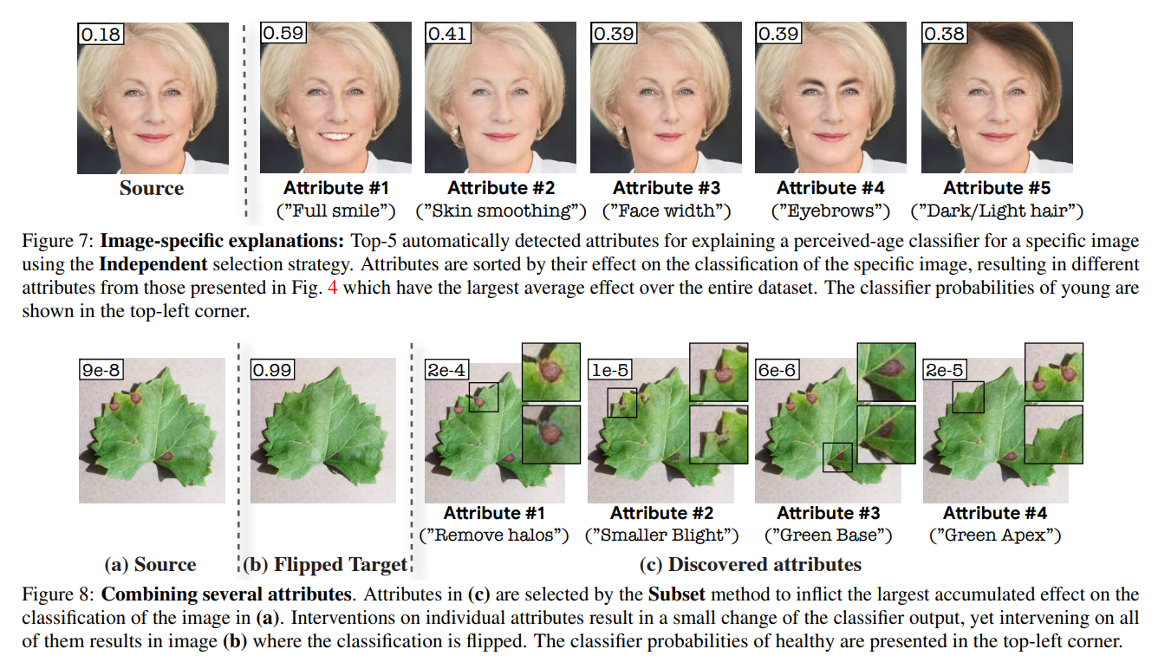
Results

Slide 11
Conclusion
StylEx
We propose the StylEx model for classifier-based training of a StyleGAN2, thus driving its StyleSpace To capture classifier-specific attributes.
• To discover classifier-related attributes in StyleSpace coordinates, and
use these for counterfactual explanations.
• To explain a large variety of classifiers and real-world complex domains.

